Slide 1
Midterm Report: NJ Second-hand Car price prediction
Presented by:
Yu zhang
Wentao Zhang
Xiaopeng Yuan
Mingxiang Zhao

Slide 2
Overview
Motivation
Background
Approach
Data Source
Methodology
Challenges and Open-questions

Slide 3
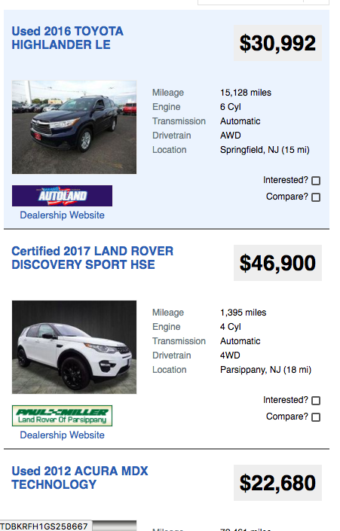

Motivation YZ
There’s no clear rules or policy on marking used-car price.
An object prices giving by third party agency will be a good reference.

Slide 4
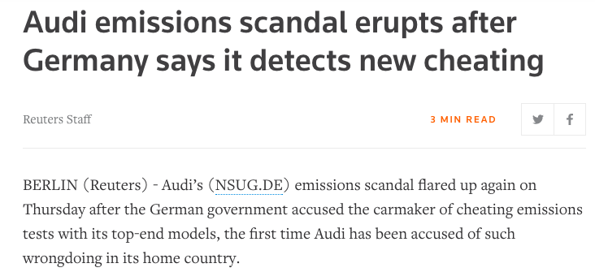
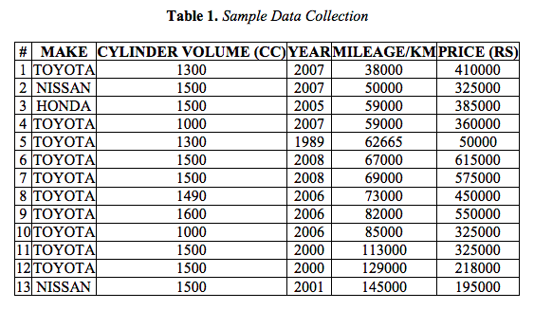
Background YZ
Current Study on this Area is not detailed enough.
All the predicting ways does not consider enough about the public opinion.

Slide 5
Preparation
Approach
Metrics
Data source
wz

Slide 6
Approach wz
Data normalization
Sentiment analysis
Raw data
Normative data
Processed data
result
Data collection
Text classification
Linear regression

Slide 7
Metrics wz
Custom metrics
PR/per hour: Number of positive reviews per hour on twitter
This will be used to express public opinion and evaluation
Relevant metrics
Brand, engine, mileage, drivetrain
Output metrics
Price

Slide 8
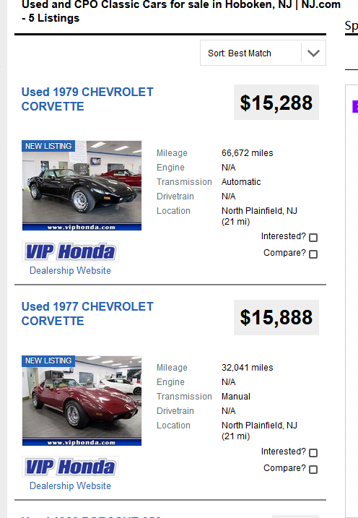
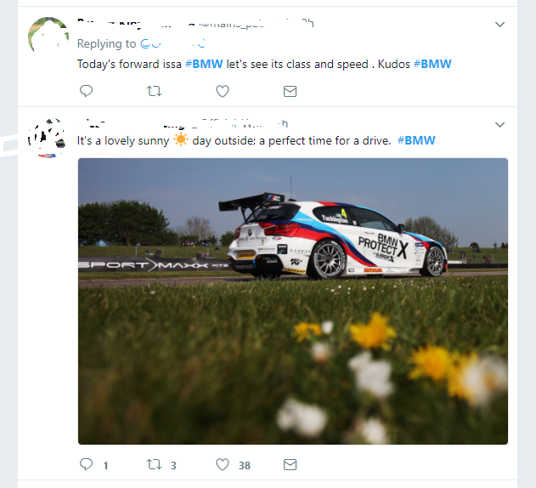
Data source wz
Relevant factors
Text from twitter

Slide 9
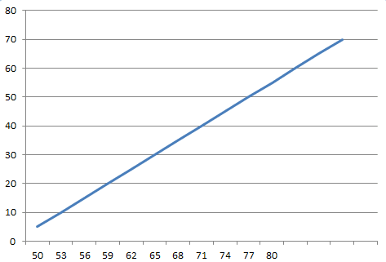
Methodology XY
Firstly we get data from autos.nj.com and then get data from the Twitter on the basis of data we get from autos.nj.com using a crawler.
Then we analyze the factors that may influence the price of the cars, we take the year, mileage, certification status, condition into consideration to predict the price of the cars.
Moreover, we also use the comments in twitter and implement sentiment analysis on them, then we rectify the predicted price base on our algorithm.

Slide 10
Challenges
MZ
Data from twitter is not enough
Honda: 1 tweet/min
BMW: 92 tweets/hour
Too much invalid info on autos.nj.com
We need normalization
Rate limit by websites

Slide 11
Open Questions
MZ
Forum: Some posts related to more than one brand or type of car may lead to ambiguity.
Interference factors from external such as the preference of engine number or output of a special model

Slide 12
Thank you!

